Slide 1
Configure - Lab
October 2022

Slide 2
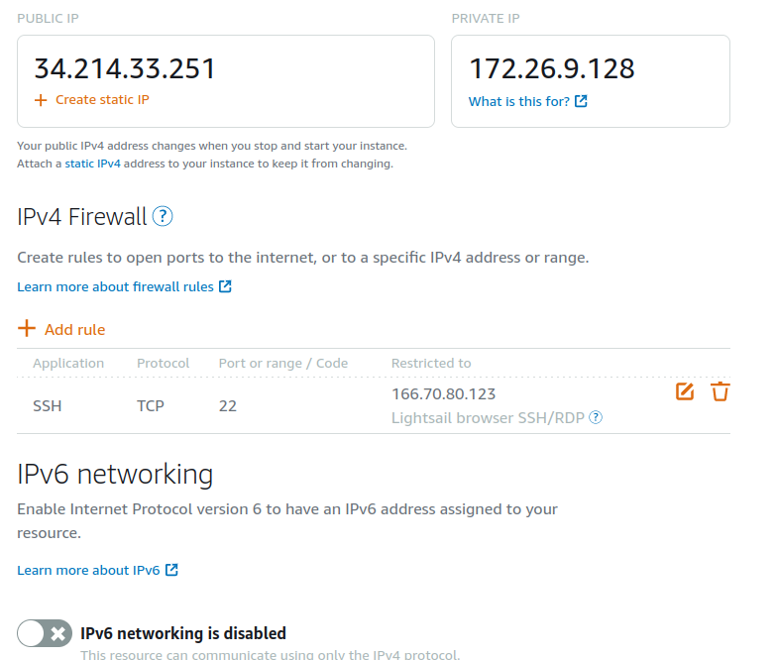
PurpleVPN - Lightsail Configuration
I have an instance for the PurpleVPN and it shows the Public and Private IP Addresses
I have set up the restriction to only allow SSH from my IP Address
Disabled IPv6 Networking

Slide 3
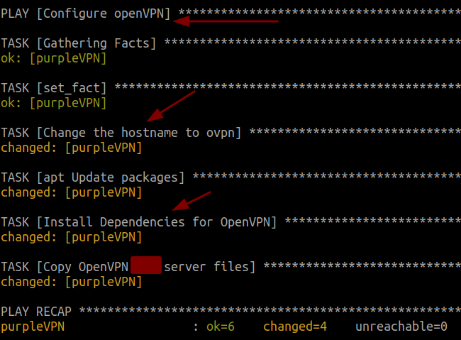
PurpleVPN - Ansible Execution
This is what it looks like for the execution of the playbook of configPurpleVPN.yml
Changes the hostname
Installs the package dependencies
Copies the openvpn-install.sh script to /home/ubuntu

Slide 4
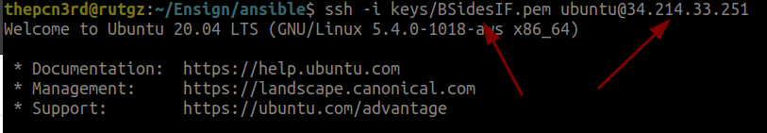

PurpleVPN - Install OpenVPN
Login with your SSH Key and IP Address for the PurpleVPN Server
Execute with sudo the openvpn-install.sh

Slide 5
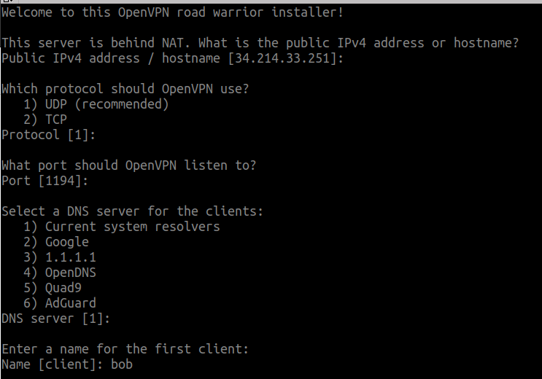
PurpleVPN - Configure OpenVPN
Should populate your external IP of the LightSail Server
UDP is Recommended
Port 1194 - Needs to be setup in LightSail firewall for access
Choose the DNS servers your clients will utilize
Each client needs a uniquely created ovpn file (You cannot reuse)

Slide 6
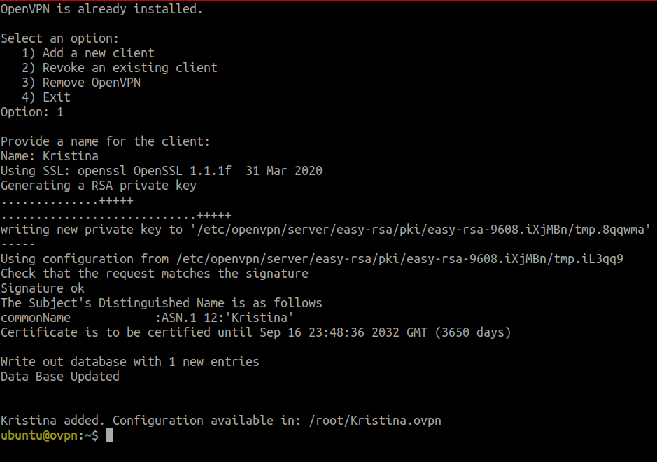
PurpleVPN - Configure OpenVPN
Rerun the installer for openvpn then select “Add a new client”
Each additional ovpn file is created under /root/<name>.ovpn
This file is provided to the person connecting to your OVPN Server remotely.
Note anyone connected to the OVPN server can see other clients connected.

Slide 7
PurpleVPN - Why OpenVPN?
Why setup an OpenVPN Server?
Allows a connected client to connect to ALL of your private IP Addresses on Lightsail
Access to insecure services to be hosted on the private IP Addresses
Usage of forward connecting tools like crackmapexec, evil-winrm and many others work
Webshells, shells and other connections work
Simulates an internal compromised device
Works great for a student environment as long as everyone plays nice!
Reverse Shells
The openvpn and routing is not setup for reverse shells, however in the lab we will use SSH and work around the limitation

Slide 8
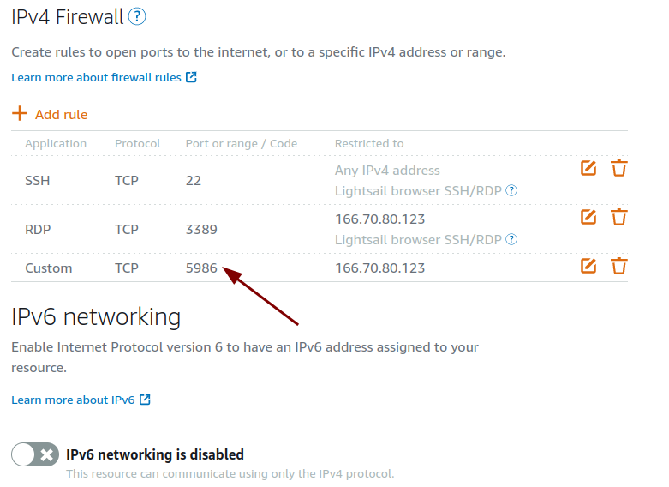
PurpleDC and PurpleMBR - Lightsail Configuration
Setup the firewall to restrict based on IP Address, for whatever reason it does not let you filter by IP on SSH (Bug?!?)
Allow Port TCP/5986 and restrict by IP Address so ansible can authenticate OR connect to the OVPN server and use the private IP Address

Slide 9
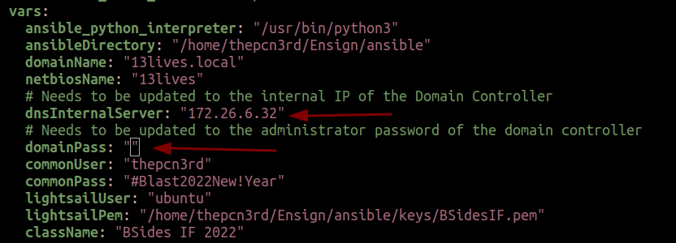
purpleDC and purpleMBR
Update the ansible_password for the respective host in the inventory.yml
Update the domainPass in the inventory.yml to be the administrator password for purpleDC
Update the dnsInternalServer to the private IP Address of the purpleDC

Slide 10
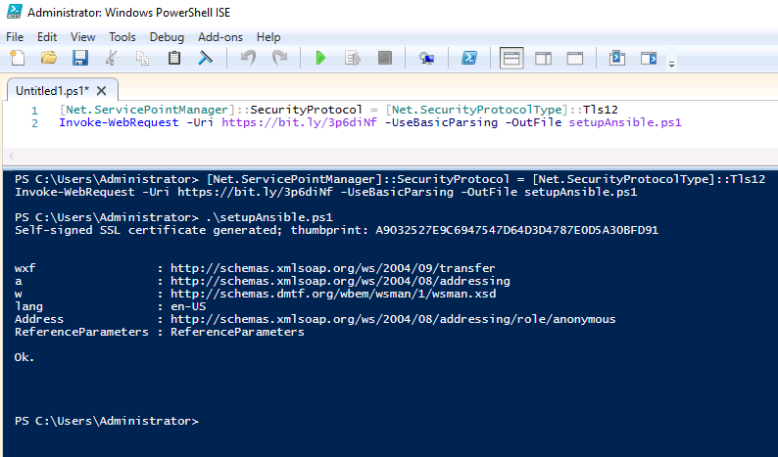
purpleDC and purpleMBR - Setup Ansible
Remember to setup ansible on these servers. I have provided a bit.ly link for convenience.

Slide 11
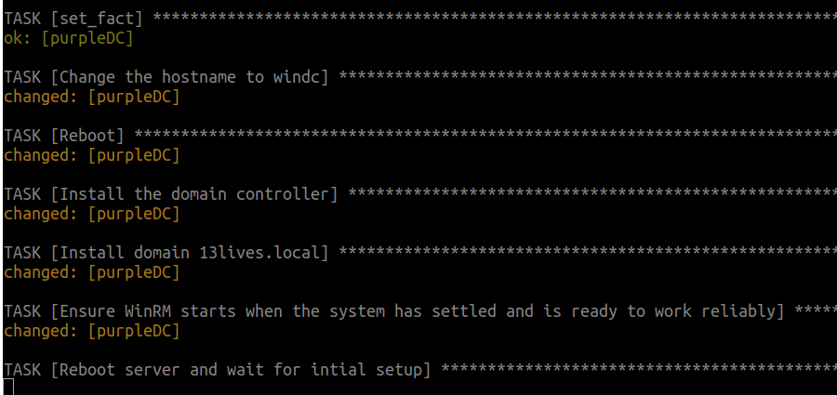
purpleDC and purpleMbr - ExecuteConfig
While running ansible if ansible is setup, the port in Lightsail is configured for TCP/5986, passwords updated in the inventory.yml file no issues should occur
Rerun the executeConfig script and comment out the playbooks of systems that worked in the configure.yml

Slide 12
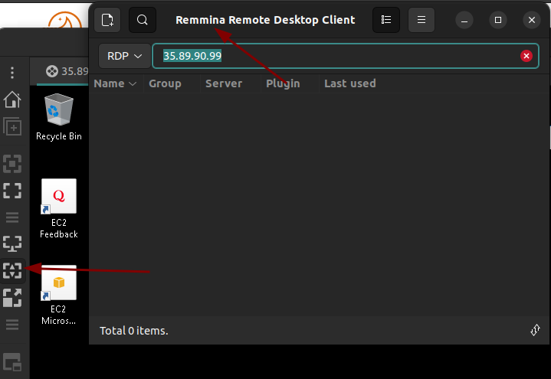
purpleDC - Remote Desktop
After installing the domain, I have had inconsistent connections using the “Connect to Remote Desktop” inside of Lightsail. I will use a tool called Remmina on Ubuntu to connect.
The second arrow points to dynamically adjust the resolution based on the size of the window. I like this setting, sometimes it distorts the view

Slide 13
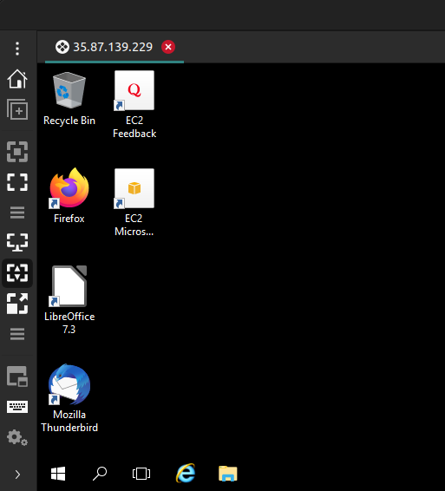
purpleMbr - Build Vulnerable User Profile
After the installation of PurpleMBR is complete, setup is required for the scenario to work. Login as prayut.c and setup his profile. (Information is in playbooks/configPurpleDC.yml)
Login as prayut.c
Password: ExpRRQvwn24SJv<xxxx>
This builds the profile for the user that needs some configuration
Observe Firefox, Thunderbird, LibreOffice and the JDK should be installed. We need to configure them

Slide 14
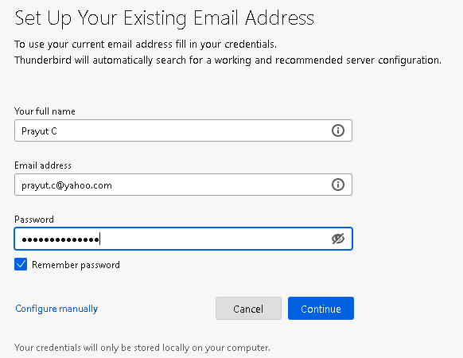
purpleMbr - Create Yahoo Account and Setup Thunderbird
Setup Thunderbird with a yahoo account that you create (Personal Opinion: Yahoo is lacking controls that end-users need in-place)
Configure the mailbox as IMAP
Authenticate
Set as Default
You should see a couple of emails in your inbox from spam

Slide 15

purpleMbr - Install Add-on FiltaQuilla
Top-right of thunderbird click the options menu and Add-ons and Themes
Search for and “Add to Thunderbird” FiltaQuilla

Slide 16
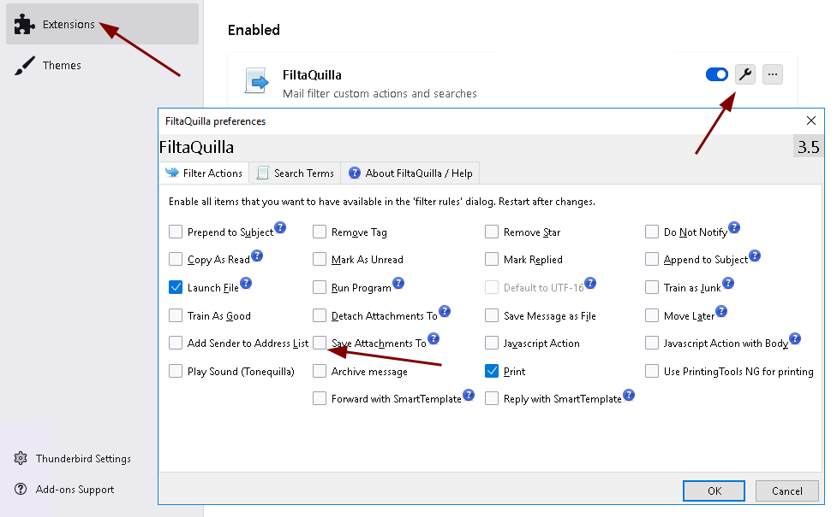
purpleMbr - Configure FiltaQuilla
After installation click on extensions, then the configure wrench icon and select Save Attachments To.
Then go back to the options menu, select Tools and Message Filters

Slide 17
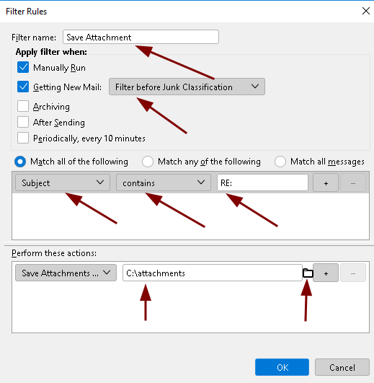
purpleMbr - Setup Message Filter
Name the filter you are creating
I setup the Subject contains a keyword like “RE:” so I can control which emails this executes against
Then configure the attachments of a received email to save to c:\attachments
The c:\attachments folder is where the powershell script triggered by a scheduled task will run the macros that exist inside of an odt file.

Slide 18
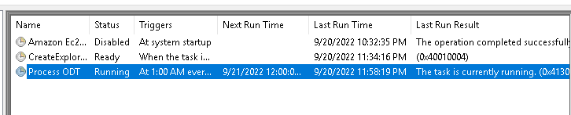
purpleMbr - Check Scheduled Task
Verify the scheduled task of “Process ODT” is executing. You may have to stop and restart the task. It should say in the “Last Run Result” the task is currently running.
Launch LibreOffice to create some necessary files

Slide 19
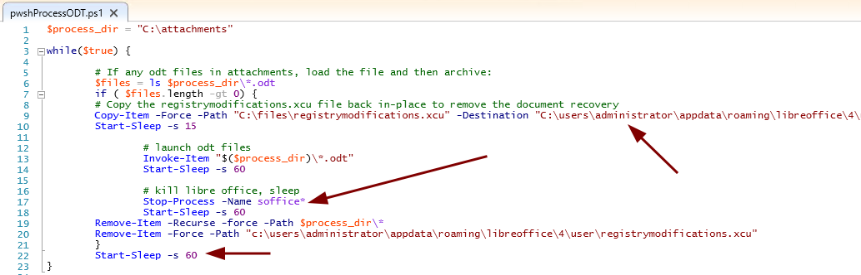
purpleMbr - pwshProcessODT.ps1
This script executes and pauses for up to 195 seconds, note that in sending in your ODT files as attachments
This also recreates the registrymodifications.xcu file, this is to reset the settings in OpenOffice for relaxed Macro security and it removes an issue of LibreOffice trying to recover the last document that crashed (Interesting Vulnerability)

Slide 20
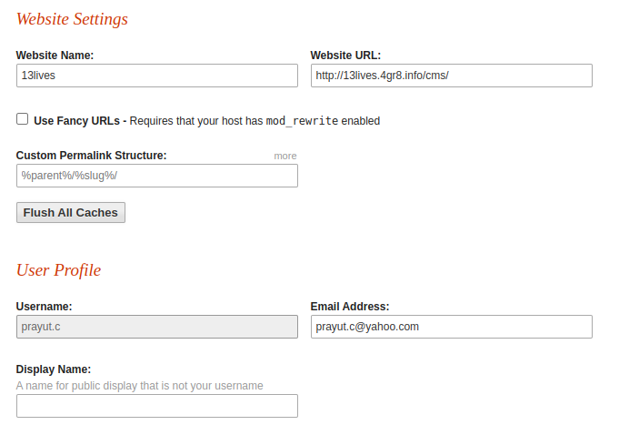
purpleLin - Initial Setup
Previously setup GetSimpleCMS with a registered DNS that I own.
I setup the yahoo account for BSidesIF 2022
The website password is not the same as the email password
The password for prayut.c is provided only to simulate an administrator logging into the site for the Persistent XSS vulnerability to work

Slide 21
purpleLin - Google Auth Setup
Setup google authenticator following the below page:
https://www.digitalocean.com/community/tutorials/how-to-set-up-multi-factor-authentication-for-ssh-on-ubuntu-18-04
Run google-authenticator for the admin user. Only change the token for the admin user for the purposes of the Lab. The admin user is not a privileged account, this account is used for purposes of the lab.

Slide 22
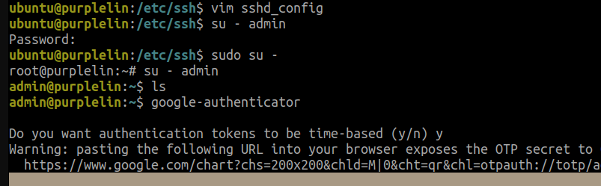
purpleLin - Google Authenticator Setup
From the SSH session of your Ubuntu user on PurpleLin, switch over to the admin account and execute “google-authenticator”
Setup the token to be time-based, allow multiple connections, and your choice on hardening from brute force.

Slide 23
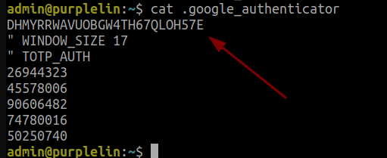
purpleLin - Google Auth Token (Step 2)
Modify the token in /home/admin/.google-authenticator to have the same secret key as is contained in the web server file /var/www/html/floatinglogs/db/floatinglogs.db

Slide 24
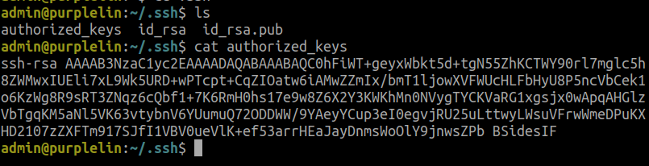
purpleLin - Setup SSH Authorized_Keys
To create the .ssh directory and appropriate files I execute “ssh-keygen” as the user (This can be done manually)
Copy or create the same authorized_keys file from /home/ubuntu/.ssh/authorized_keys for the admin user. This allows the BSidesIF SSH key to be utilized in conjunction with the google auth token.

Slide 25
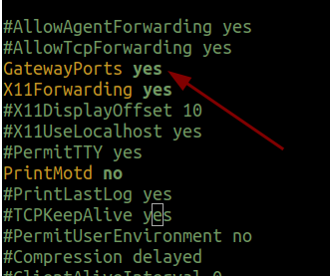
purpleLin - Setup SSH GatewayPorts
Modify /etc/ssh/sshd_config and change GatewayPorts from being commented out and set to yes.
This is for convenience of allowing a SSH reverse tunnel to listen on the 172.16.x.x private IP Address. (Other tools could be used like socat)
This reverse tunnel is used from the phishing that we will conduct.

